Slide 1
IPL predictions using ML
CS 419 Course Project Team 17

Slide 2
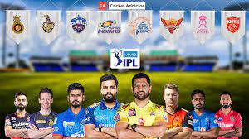

About IPL
Currently, with ten teams, the round-robin format was scrapped and two virtual groups of five were introduced similar to the 2011 season in the league phase. After the league stage, the top four teams will qualify for the playoffs. The top two teams from the league phase will play against each other in the first Qualifying match, with the winner going straight to the IPL final and the loser getting another chance to qualify for the IPL final by playing the second Qualifying match.

Slide 3
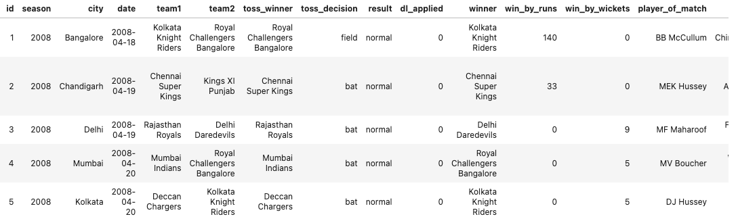
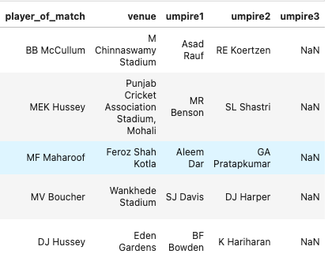
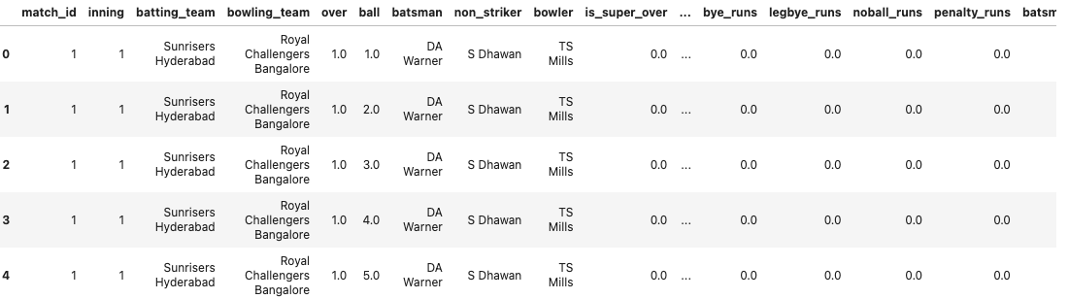
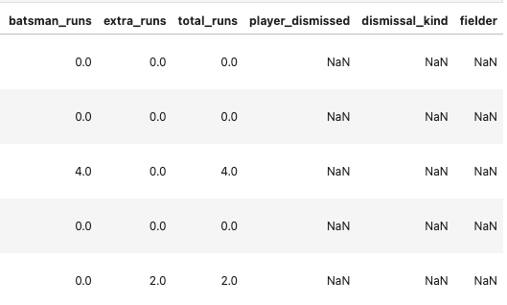
Datasets

Slide 4
Datasets
We have taken the datasets from Kaggle, namely,:-
Deliveries
Matches
where the data of all editions of the IPL so far was available.
One for overall matches data and one for ball-to-ball data for the full 2008-2020 period.
Both the datasets are linked by the ’id’ column which represents the matches uniquely.
Some of the useful features present in the dataset are date of match, venue, run(s) and wicket(if any) on every ball, toss decision, batsman and bowler, result of match with margin etc.
There are some minor discrepancies in data such as missing values in ‘bowling team’ column and duplicate team name but it doesn’t hurt the predictions task as team data is also present in ‘team1’,’team2’ columns.
The dataset consists of 2 lakh data points with 18 features in total.

Slide 5
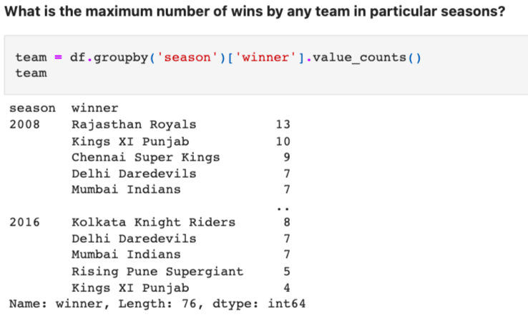
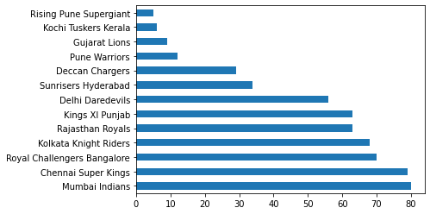
Analysis Pipeline
As observed from the literature survey conducted, a large
majority of the predictive models that were made are used
to predict the outcome of the match and this prediction is
made before the start of the match. This prediction will be
useful for the team to make long-term decisions for the team
to perform better in the tournament as a whole but is not very
useful during the match itself as no changes can be made to
the team in the middle of a match. The work discussed in this
paper seeks to fill in this gap by providing data to the team
at various phases of the match so that the team can make
informed decisions such as what batting order and bowling
order to use for the rest of the game.

Slide 6
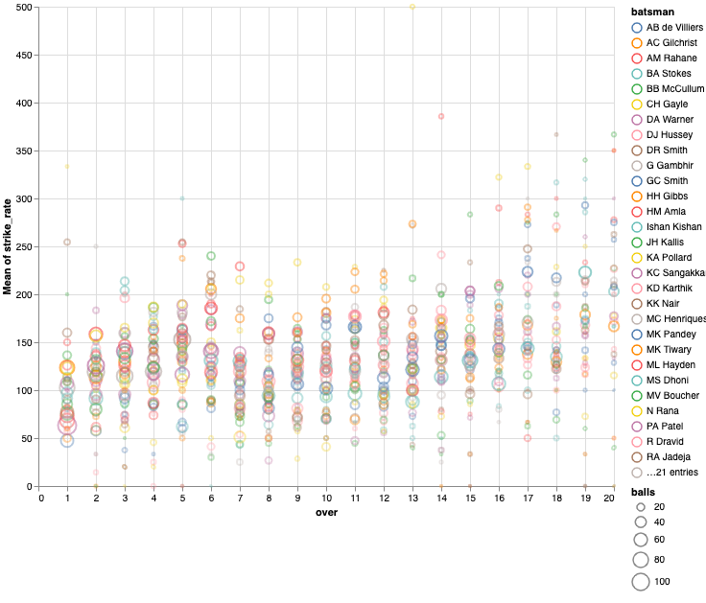
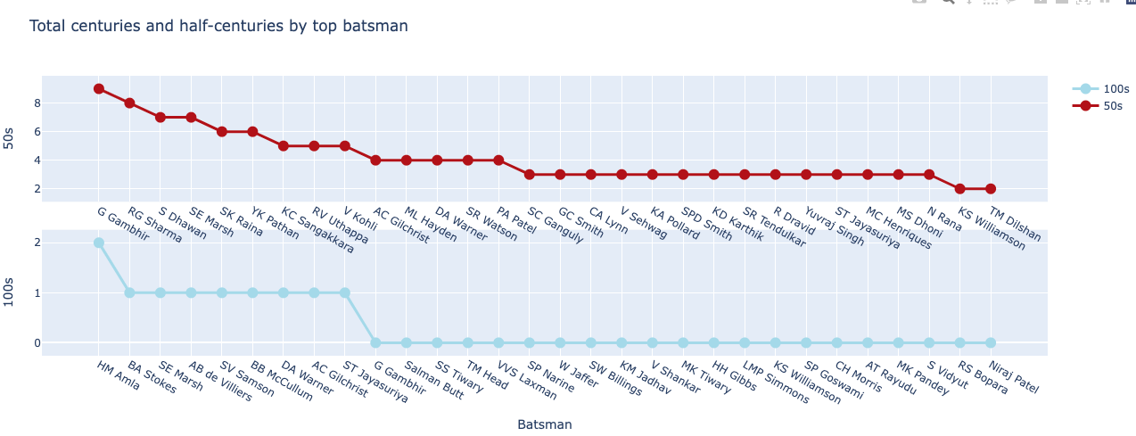
Analysis Pipeline

Slide 7
EDA
REGRESSION
CLASSIFICATION
Organised and classified representation of the data given in the datasets using functions like head
Here we have used both matches and ball by ball dataset for predicting the final score of match. The features which are used for predicting are:
over cur, batsman runs, total runs y, CUMSUM runs, CUMSUM wickets, batting team, bowling team, venue, is wicket
We are using matches data set for predicting the winner of match.
The features which are used for predicting are: team1, team2, team1 toss win, team1 win, venue

Slide 8
Regression Task
Gradient Boosting Regressor:
Random Forest Regressor:
Extra Trees Regressor:
‘Boosting’ refers to one by one adding weak learner sub-models or more specifically decision trees (weak learner denoting a learner performing slightly better than chance).
Random Forests achieve a reduction in overfitting by combining many weak learners that underfit because they only utilize a subset of all training samples.
Random forest uses bootstrap replicas, that is to say, it subsamples the input data with replacement, whereas Extra Trees use the whole original sample.

Slide 9
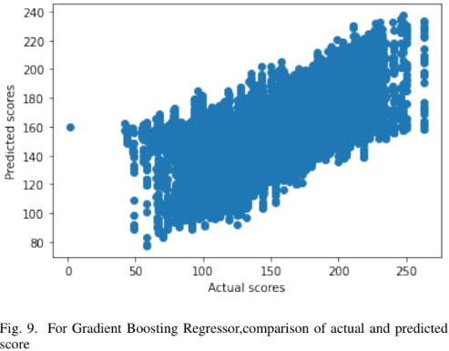
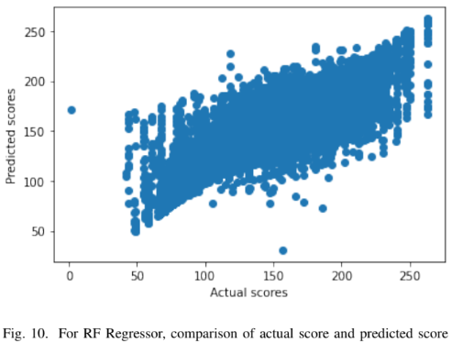
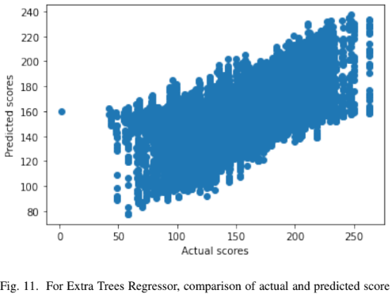
Regression Task: Results
Gradient Boosting Regressor:
Random Forest Regressor:
Extra Trees Regressor:
Results:
Accuracy on testing data: 41.96%
Mean Absolute Error: 17.05
Root Mean Squared Error: 23.09
Custom Accuracy: 41.3%
Results:
Accuracy on testing data: 77.79%
Mean Absolute Error: 9.1
Root Mean Squared Error: 14.28
Custom Accuracy: 69.80%
Result:
Accuracy on testing data: 74.96%
Mean Absolute Error: 17.05
Root Mean Squared Error: 23.09
Custom Accuracy: 41.3%

Slide 10
Classification Task
SVM:
Random Forest Classifier:
Decision Tree Classifier:
A support vector machine (SVM) is a supervised machine learning model that uses classification algorithms for two-group classification problems.
After giving an SVM model sets of labeled training data for each category, they’re able to categorize new text.
A random forest is a meta estimator that fits a number of decision tree classifiers on various sub-samples of the dataset and uses averaging to improve the predictive accuracy and control over-fitting.
The sub-sample size is controlled with the max samples parameter if bootstrap=True (default), otherwise the whole dataset is used to build each tree.
Decision Trees are a type of Supervised Machine Learning (that is you explain what the input is and what the corresponding output is in the training data) where the data is continuously split according to a certain parameter.
The tree can be explained by two entities, namely decision nodes and leaves. The leaves are the decisions or the final outcomes.

Slide 11
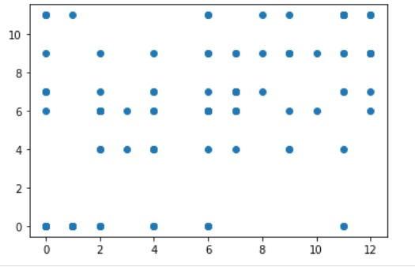
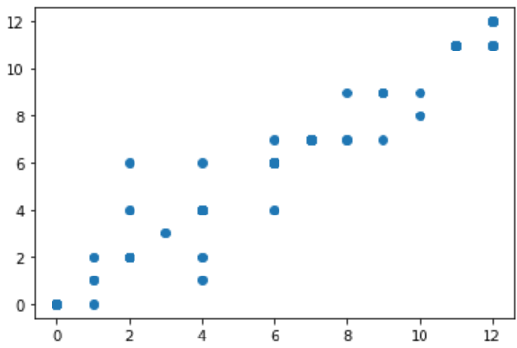
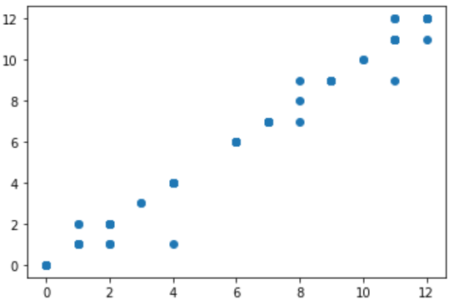
Classification Task: Results
SVM:
Random Forest Classifier:
Decision Tree Classifier:
We get accuracy of 31.3% on test set when we use Support Vector Classifier(SVC).
We get accuracy of 80% on test set when we use Random Forest Classifier.
We get accuracy of 88.69% on test set when we use Random Forest Classifier.

Slide 12
Discussion
For the Classification task we get maximum accuracy using Decision Tree Classifier of 98.7% followed by Random Forest Classifier of 85.3% for predicting the winner of match.
For the Regression task we get maximum accuracy using Random Forest Regressor of 77.79% followed by Extra Trees Regressor of 74.96% for predicting the final score of the match.
Which one is better?

Slide 13
Conclusion
This presentation provides useful insights from IPL dataset about what are the best performing teams and players. Best performing players of IPL can be listed with the most MoM awards analysis. Sponsors can focus on which stadium host the IPL matches most to analyze the audience in those areas specifically and make their plans accordingly.
The prediction of winner of the match gives us a very accurate accuracy. The prediction of final score at any given moment of match is currently done with the help of Current Run Rate (CRR), while it is one of the useful features, it doesn’t take into account what are the remaining overs and scores of the batsmen at crease.
The models proposed in the work take these features into account to predict the final score given these features at any point in the game. Due to limited data, the best model is 80% accurate.

Slide 14
Contributions
Name | Contributions
Goransh Gattani | Coding, Presentation and Report
Ishita Tyagi | Presentation and Coding
Laxita Karnawat | Analysed the problem and Made the POA
Prashul Vaishnav | Coding and Report
Pulkit Jindal | Executing the POA and Report

